Slide 1
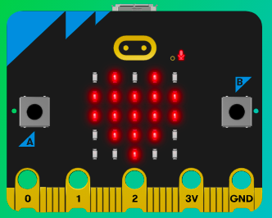
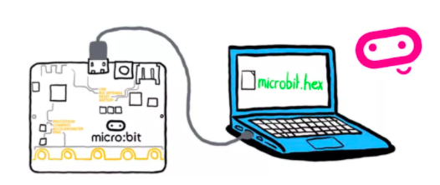
MicroMakers!
KIDS’ MAKER CLUB OF WASHINGTON, DC
Meet Up #18

Slide 2
RECAP!
Notes:
LEDs, Buttons, Light Sensor

Slide 3
RECAP!
Variable
Function
Syntax
Bugs
Bells and Whistles

Slide 4
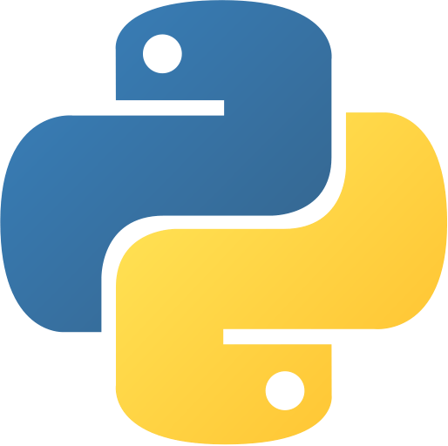
PYTHON

Slide 5
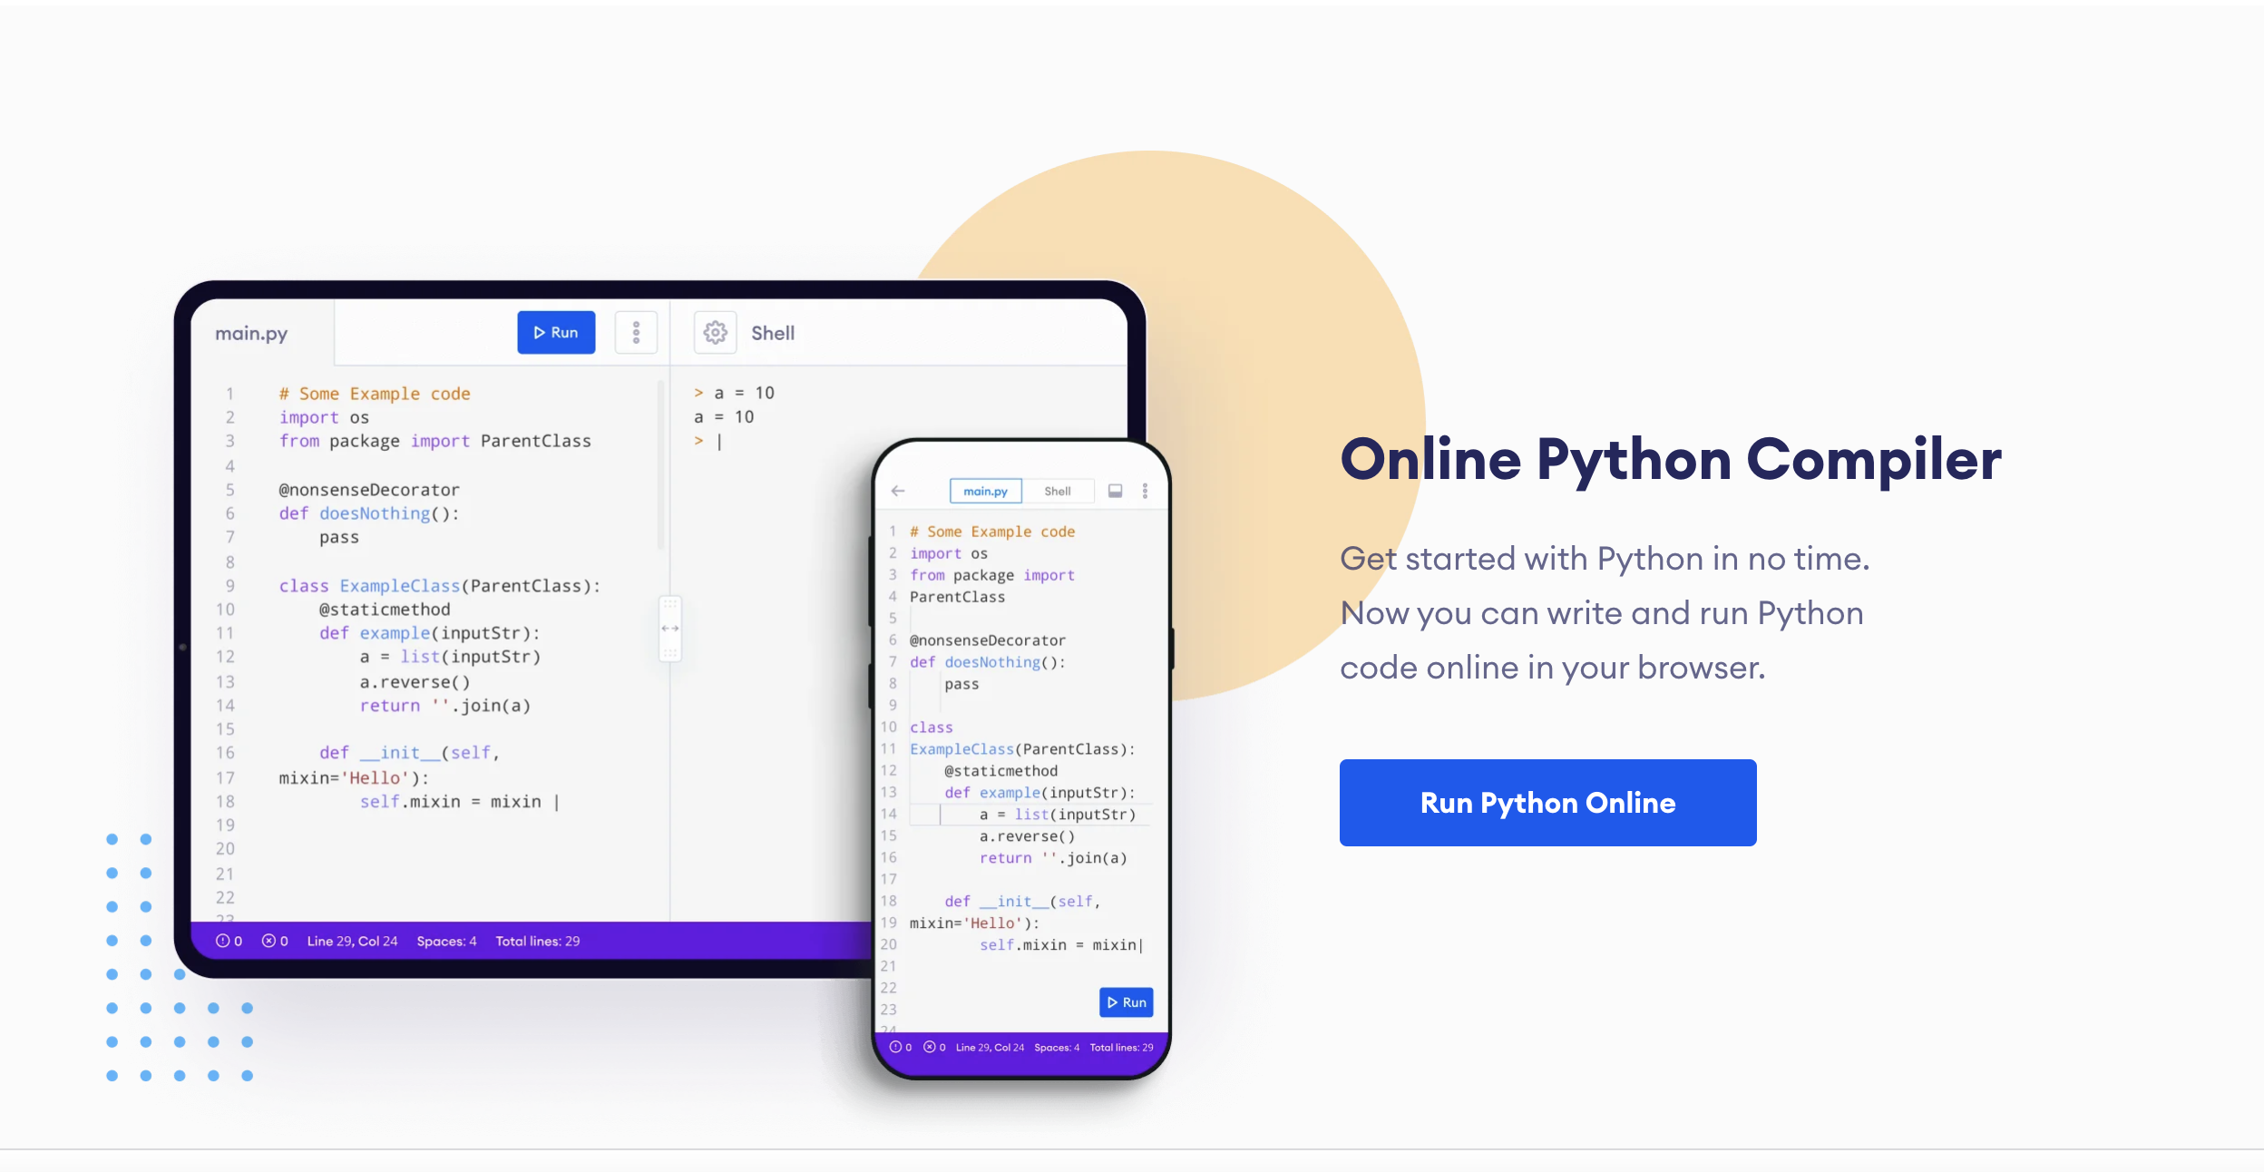
Let’s Get Started
Using an online code editor and compiler
Go to: https://www.programiz.com
Find and click this button:

Slide 6
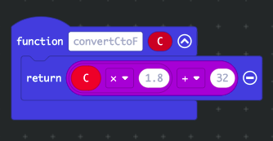
Functions!
Remember this?
Function Components
Name of the Function
Inputs
Processing Steps
Output
Notes:
From Robot Turtles, what is a function?

Slide 7
Syntax
Computers are very picky!
Functions
Recap: Functions receive an input to produce an output
print ()
input ()

Slide 8
Syntax
Computers are very picky!
Functions
Debugging! Which of the following functions will not work, and why?
print (“I love cream cheese.”)
print (“I love eggs, too.”) (“and ham.”)
Print (But broccoli is the best.)
print (“Sue’s favorite food is {food}.”)
food = input (“What is your favorite food?”)
print f(“Breakfast rocks.”)

Slide 9
Syntax
Computers are very picky!
Variables
Recap: Variables have a name (fixed) and a value (that can change)
To create a variable, first give it a name. There are rules for this:
Only letters – no numbers, symbols, or spaces allowed.
Camel case – first letter is lowercase. If combining to words, second is uppercase, like this: “firstSecond”
A variable can have a number or “string” value. If a “string”, must be in quotes. A string can be numbers, letters, or a combination.
In Python to assign a value to a variable, write an =.
Example:
food = “beans”
myAge = 12

Slide 10
Syntax
Computers are very picky!
Variables
Debugging! Which of the following variable statements will not work, and why?
name = “bananas”
food = bananas
score = “3”
My score = 3
luv2Sail = “yes”

Slide 11

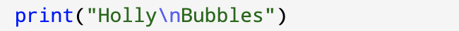
Syntax
Computers are very picky!
Fancy Stuff
Creating a new line in your input () and print () statements makes your program look neat.
Most code editors will color code your program to help you debug as you type.

Slide 12
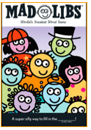
Step 1: The Project
Mad Libs!
What is it?
Ask players to name simple nouns, verbs, and adjectives. User their responses to create an… unusual story.
What do I need?
A code editor, Python, and a compiler (online or installed on your computer.

Slide 13
Step 2: How Does it Work?
Create 3 or 4 variables whose values rely on user inputs.
Example: food = input (“Name a food: “)
Write a story that uses these inputs. Print the story in the console.
Example: print (f”Once upon a time, there was a boy who loved to eat {food}.”)

Slide 14
Step 3: Code It
Your first coding building blocks
No hints here – you’ll have to rely on your notes!

Slide 15
Step 4: Share Your Creation!

Slide 16
My Computer Did My Math Homework for Me
Python already knows how to do basic math. Can you guess what these operators do?
+
-
/
*
**

Slide 17
My Computer Did My Math Homework for Me
We already know how to print strings. The print () function can also print results from calculations. What do you think will happen when you run the following code?
print (3*6)
print (3**2)
print (”The answer is (4+5).”)
print (”The answer is {4+5}.”)
print (f”The answer is {4+5}.”)

Slide 18
My Computer Did My Math Homework for Me
Now, we want the computer to be our calculator. What do you think will happen when we try this code:
a = input (“Enter a number between 1 and 100:\n”)
b = input (“Enter another number between 1 and 100:\n”)
print (f”When I add these together, I get {a+b}”)

Slide 19
My Computer Did My Math Homework for Me
What happened!? When you entered the numbers, the computer didn’t know you entered numbers. Silly computer. The computer thought you were entering strings. To illustrate, try the code again, but for a and b, use letters instead:
firstLetter = input (“Enter a letter:\n”)
secondLetter = input (“Enter another letter:\n”)
print (f”When I add these together, I get: {firstLetter + secondLetter}”)

Slide 20
My Computer Did My Math Homework for Me
To help your computer understand the difference between numbers meant to be interpreted as numbers versus numbers being interpreted as strings, try this integer function:
int()
What do you think this function does? Try it:
a = int(input(“Enter a number between 1 and 100:\n”))
b = int(input(“Enter another number between 1 and 100:\n”))
print (f”When I add them together, I get:{a+b}”)
If a = 2 and b = 4, what will the program do? Try it and see!

Slide 21
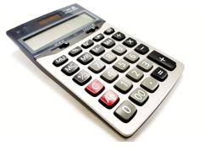
Step 1: The Project
The Area Finder
What is it?
Ask players to provide the height and width of a 4-sided rectangle or square. The program will calculate the area of the shape.
What do I need?
A code editor, Python, and a compiler (online or installed on your computer.
height
width

Slide 22
Step 2: How Does it Work?
Create two variables “height” and “width”. Ask the user to enter a value for each.
Example: height = int (input(“Enter the height of the shape:\n”)
Multiply the variables together and print the result.
Example: print (f”The area is: {height*width}.”)

Slide 23
Step 3: Code It
Your first coding building blocks
No hints here – you’ll have to rely on your notes!

Slide 24
Step 4: Share Your Creation!

Slide 25
CREATE!
Write your own program using what you’ve learned so far:
Program planning:
Write what you want the program to do in plain language
Write pseudo-code
Code it
Debug!
Use:
variables
input ()
print ()
int ()

Slide 26
NEXT TIME
More Python Coming!
Getting ready to write our own Choose Your Own Adventure Stories!
ASCII Art
If / Then / Else Statements

Slide 27
TIME TO PUT AWAY OUR COMPUTERS!
Neat and tidy, please!
Let’s leave this beautiful room as lovely as we found it!

Slide 28

UNTIL NEXT TIME….
MicroMakers!
Slides and Script: Holly Krambeck (learningpython64@gmail.com)

